Slide 1
^{Women’s}
^{Mental Health} ^{Training}
^{THINKING WELL,}
^{Living Well}
A Resource for Churches on Comprehensive Health Ministry

Slide 2
Living the Abundant Life: God’s Healing Way
Written by
Kathleen Kiem Hoa Oey Kuntaraf, MD, MPH

Slide 3
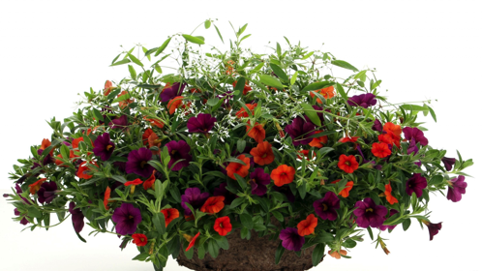
“I am come that they might have life, and that they might have it
more abundantly.”
John 10:10
Notes:
The British Medical Journal once reported an unusual case of the rare and bizarre de Clerambault's syndrome, in which a 36-year-old unmarried female clerk had a very strong delusion that her director was in love with her. This was amazing because she had never spoken to her boss, a married man; however, she had written fourteen love letters to him. What a one-sided affair! When doctors examined her, it was found that she was suffering from Grave's Disease. This untreated case of hyperthyroidism caused an imbalanced hormonal state, creating the delusion that her director was in love with her. Once the problem was diagnosed, the doctor was able to provide a prescription and her condition improved.
Some of us may have distorted thinking, but God, the Great Physician, has given us a wholistic prescription on how to live a healthy, balanced, abundant life.
God is interested in our enjoying abundant living. As it says in John 10:10: “I am come that they might have life, and that they might have it more abundantly.”

Slide 4
God’s Wholistic Prescription
"Pure air, sunlight, abstemiousness, rest, exercise, proper diet, the use of water, trust in divine power—these are the true remedies.
Ellen G. White, The Ministry of Healing, p. 127.
Notes:
What is God’s wholistic prescription that will allow us to live an abundant life? In the writings of Ellen G. White, one of the founders of the Seventh-day Adventist Church, we find a wholistic prescription for an abundant life: "Pure air, sunlight, abstemiousness, rest, exercise, proper diet, the use of water, trust in divine power—these are the true remedies.“ (The Ministry of Healing, p. 127)

Slide 5
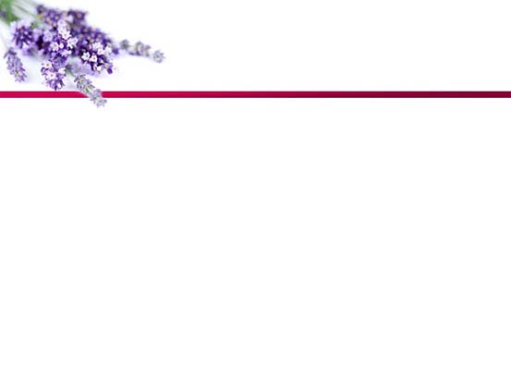
God’s Wholistic Prescription
C - Choices
E - Exercise
L - Liquids
E - Environment
B - Belief
R - Rest
A - Air
T - Temperance
I - Integrity
O - Optimism
N - Nutrition
S - Social Support
Notes:
Many acronyms have been developed to help us remember these eight natural remedies. The General Conference Health Ministries department has gathered all the proven practices that ensure the best possible health for abundant living using the acronym CELEBRATIONS. These elements of CELEBRATIONS help us live a healthy life.
C-Choices
E-Exercise
L-Liquids
E-Environment
B-Belief
R-Rest
A-Air
T-Temperance
I-Integrity
O-Optimism
N-Nutrition
S-Social Support and Services
We need the total package of the wholistic prescription to enjoy an abundant life. For instance, what’s the use of being a devout vegetarian, if you do not get sufficient sleep to keep you from being grouchy and irritable? Or if we avoid alcohol but do not exercise, our health will still suffer.

Slide 6
God’s Wholistic Prescription
A pure healthy life is most favorable for the perfection of Christian character and for the development of the powers of mind and body.”
Ellen G. White, My Life Today, p. 125.
Notes:
An article in the November 2005 National Geographic tells of three groups of centenarians—the Okinawans, the Sardinians, and the Seventh-day Adventists living in Loma Linda, California. Examples from Loma Linda included Dr. Ellsworth Wareham, who at age 91 was assisting with heart surgery; Frank Shearer who at 100 years old is still skiing; Marge Jetton who at age 101 had her driver’s license extended for another 5 years; and Lydia Newton, 112 years old, ranked among the world’s 20 oldest people.
If we abide by the wholistic prescription God has given us, there is a possibility for us to live some ten years longer than those who do not follow the principles of healthful living. A quotation from Ellen G. White suggests a further benefit of healthful living: “A pure healthy life is most favorable for the perfection of Christian character and for the development of the powers of mind and body.” (My Life Today, p. 125)
It is clear that when we are healthy, beside the possibility of having ten additional years here on earth, we are also creating an environment to develop a Christ-like character, making us fit for heaven where we will enjoy an abundant life with Jesus forever. That is surely living the abundant life in its truest meaning. Yes, Jesus came to this earth so we might have life and have it more abundantly both here and hereafter. What a loving God we have!

Slide 7
C.E.L.E.B.R.A.T.I.O.N.S.
C is for celebrating CHOICES
Choosing health and celebrating the joy of life should be an intentional decision that is well informed and freely made.
Notes:
Using the acronym CELEBRATIONS, let us look at each part of God’s Wholistic prescription.
C is for celebrating Choices
Whether we realize it or not, we are constantly making choices moment by moment. For instance we choose: whether to exercise regularly; whether to get enough sleep; whether to eat healthfully; whether to drink enough water; whether to be helpful to others.
Choosing health and celebrating the joy of life should be an intentional decision that is well informed and freely made. As early twentieth-century politician William Jennings Bryan said, “Destiny is no matter of chance. It is a matter of choice.”
The entire philosophy of CELEBRATIONS involves individuals making their own choices backed by evidence-based information—a lifestyle which relates to the body, mind, emotions, spiritual dimensions, and social interaction.
According to the 2006 study conducted by Indiana University-Purdue University, Fort Wayne (IPFW), nearly 90% of healthcare claim costs can be attributed to an individual’s lifestyle choices. It is the consistency of making healthy choices that will turn into habits and ultimately lead to life improvement. As Abraham Lincoln observed, “The health you enjoy is largely your choice.”
What is the source of strength to make correct choices on a regular basis? Philippians 4:13 gives a very clear answer. “I can do all things through Christ who strengthens me.”

Slide 8
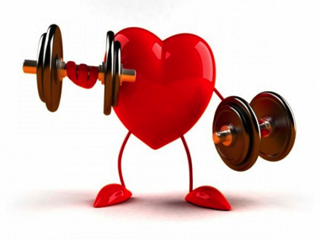
C.E.L.E.B.R.A.T.I.O.N.S.
E is for celebrating EXERCISE
The U.S. Surgeon General’s Report on Physical Activity and Health states that physical exercise is the best single predictor of longevity. In other words, if you want to postpone your funeral, exercise regularly!
Notes:
E is for celebrating Exercise
The U.S. Surgeon General’s Report on Physical Activity and Health states that physical exercise is the best single predictor of longevity. In other words, if you want to postpone your funeral, exercise regularly!
An advisory committee, composed of 13 leading experts in the field of exercise science and public health, summarizes the benefits of exercise for various age groups as follows.
Children and Adolescents – Strong Evidence of
Improved cardiorespiratory and muscular fitness
Improved bone health
Improved cardiovascular and metabolic health biomarkers
Favorable body composition
Children and Adolescents – Moderate Evidence of
Reduced symptoms of depression

Slide 9
C.E.L.E.B.R.A.T.I.O.N.S.
Adults and Older Adults – Strong evidence of
Lower risk of early death
Lower risk of coronary heart disease
Lower risk of stroke
Lower risk of high blood pressure
Lower risk of adverse blood lipid profile
Lower risk of type 2 diabetes
Notes:
Adults and Older Adults – Strong evidence of
Lower risk of early death
Lower risk of coronary heart disease
Lower risk of stroke
Lower risk of high blood pressure
Lower risk of adverse blood lipid profile
Lower risk of type 2 diabetes
Lower risk of metabolic syndrome
Lower risk of colon cancer
Lower risk of breast cancer
Prevention of weight gain
Weight loss, particularly when combined with reduced caloric intake
Improved cardiorespiratory and muscular fitness
Prevention of falls
Reduced depression
Better cognitive function (for older adults)
Moderate to Strong Evidence of
Better functional health (for older adults)
Reduced abdominal obesity
Moderate Evidence of
Lower risk of hip fracture
Lower risk of lung cancer
Lower risk of endometrial cancer
Weight maintenance after weight loss
Increased bone density
Improved sleep quality.

Slide 10
C.E.L.E.B.R.A.T.I.O.N.S.
“Walking, in all cases where it is possible, is the best remedy for diseased bodies, because in this exercise all the organs of the body are brought into use… There is no exercise that can take the place of walking. By it circulation
of the blood is improved.”
Ellen G. White, Counsels on Health, p. 125.
Notes:
The current Physical Activity Guidelines for Americans encourage a person to accumulate at least two and a half hours a week in moderate-intensity physical activity, such as brisk walking. Physical activity up to one hour per day results in further reduction of risk for cardiovascular disease. The InStep for Life program of the General Conference Health Ministries Department recommends walking at least 8000 steps daily. Walking 10,000 steps daily would be ideal. So check your pedometer each day to see if you have reached your daily goal.
It is amazing that Dr. Kenneth Cooper, of Aerobics fame, who used to promote jogging, is currently promoting brisk walking rather than running or jogging. Remember the slogan “no pain no gain”? Unfortunately, some people may continue to run until their whole body is sore, which could be harmful rather than beneficial. However, walking puts much less stress on the body. In addition, it can be done almost any time or place. It’s fun, convenient, inexpensive, and can be enjoyed alone or with friends. It requires no special equipment. Comfortable walking shoes and clothing are all that are needed. Brisk walking results in minimal injuries while exercising most muscles and systems of the body. It stimulates the release of endorphins, which elevate the mood and improve one’s outlook on life.
More than 150 years ago Ellen White recognized the value of walking, writing that, “Walking, in all cases where it is possible, is the best remedy for diseased bodies, because in this exercise all the organs of the body are brought into use… There is no exercise that can take the place of walking. By it circulation of the blood is improved.” (Counsels on Health, p. 125)
A daily walk can improve your health and your mood, so get your pedometer and comfortable shoes and start today.

Slide 11
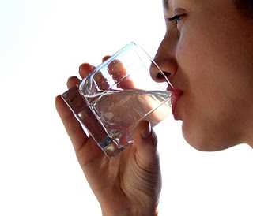
C.E.L.E.B.R.A.T.I.O.N.S.
L is for celebrating LIQUIDS
Water, the liquid of life, is a medium in which metabolism takes place.
Notes:
L is for celebrating Liquids
Liquid is indispensable for optimal health. Almost every cell and tissue of the body not only contains water but is continually bathed in fluid and requires water to perform its functions. Water, the liquid of life, is a medium in which metabolism takes place. It serves many vital purposes, as…
the transport system within the body
a lubricant for movement
the facilitator of digestion
the prime transporter of waste via the kidneys
a temperature regulator
a major constituent of the circulating blood
Many problems arise if we do not drink sufficient water. The body will attempt to avoid dehydration by decreasing sweat and urine output. If this compensatory mechanism proves inadequate and insufficient fluid intake persists, dehydration will occur. As a result, the body’s cooling mechanisms will be impaired, along with the possible rise in body temperature and an inefficient clearance of body waste. The blood thickens and blood flow becomes impaired, increasing the risk of intravascular clotting. This may manifest as stroke or heart attack. It also leads to constipation, to the delight of the laxative industry. Not drinking enough water also increases the risk of developing kidney and gallstones.
In 1995, an article in The Journal of the American Medical Association called attention to the hazards facing older Americans from inadequate fluid intake. It’s estimated that by drinking enough water, older people could save thousands of days of hospitalization and millions of dollars each year. Such an observation has implications for all age groups worldwide.

Slide 12
C.E.L.E.B.R.A.T.I.O.N.S.
“In health and in sickness, pure water is one of heaven's choicest blessings. Its proper use promotes health. It is the beverage which God provided to quench the thirst of animals and man. Drunk freely, it helps to supply the necessities of the system and assists nature to resist disease.”
Ellen G. White, The Ministry of Healing, p. 125.
Notes:
Amazingly Mrs. White has counseled this more than 150 years ago, saying, “In health and in sickness, pure water is one of heaven's choicest blessings. Its proper use promotes health. It is the beverage which God provided to quench the thirst of animals and man. Drunk freely, it helps to supply the necessities of the system and assists nature to resist disease.” (The Ministry of Healing, p. 125)
To help stay hydrated during prolonged physical activity or in hot weather, the 2005 Dietary Guidelines for Americans recommends that we drink fluids during the activity as well as several glasses of water or other fluid after the physical activity is completed.
In the healthy person, a practical guide to water intake is to drink water in the morning because the body is relatively dehydrated from insensible (invisible) water loss, or perspiration, during sleep. Then continue to drink water at regular intervals throughout the day to ensure that the urine is a pale color. (Urine may be a bright yellow color after taking certain medications, including vitamin pills and anti-tuberculosis medication.)

Slide 13
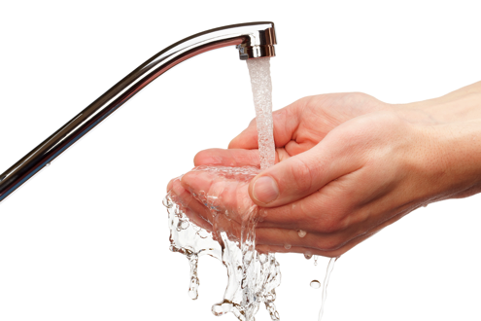
C.E.L.E.B.R.A.T.I.O.N.S.
Frequent hand washing may reduce transmission of many infectious agents from person to person.
Notes:
Another important use of water is cleansing. Frequent hand washing may reduce transmission of many infectious agents from person to person. If people thoroughly washed their hands with soap and water before eating and after activities that soil their hands, a large percentage of infectious diseases would be eliminated.
Aside from using water internally for our bodies, we also need to use it externally. Hydrotherapy is a simple home therapeutic application using water, and it is best applied as a help for simple muscular aches, pains, and bruises. When dealing with muscular aches, apply hot, wet towels alternated with cold, wet towels (ending with a cold application) to affected areas to improve blood flow. However, for a recent injury where bruising has occurred, cold compresses are more appropriate.
Caution should also be exercised where the skin is diseased or cut, has impaired blood flow, or where neurological damage causes the inability to feel heat. In this case, hot applications may lead to serious injury (for example, in diabetic patients).
There are many other modes of hydrotherapy, such as cold mitten friction, hot footbaths, heat compresses, and ice compresses. Unfortunately, few today utilize this most useful tool for relief.

Slide 14
C.E.L.E.B.R.A.T.I.O.N.S.
“The external application of water is one of the easiest and most satisfactory ways of regulating the circulation of the blood....But many have never learned by experience the beneficial effects of the proper use of water. All should become intelligent in its use in simple home treatments.”
Ellen G. White, The Ministry of Healing, p. 156
Notes:
Regarding the beneficial uses of water, Mrs. White made the following statement: “The external application of water is one of the easiest and most satisfactory ways of regulating the circulation of the blood....But many have never learned by experience the beneficial effects of the proper use of water. All should become intelligent in its use in simple home treatments.” (The Ministry of Healing, p. 156)
Notice that she advises that all should become intelligent in its use. So this knowledge is valuable not only for nurses or physiotherapists but for all of us.
There is one particular type of hydrotherapy that we use regularly, which is the daily shower. It removes accumulated dirt and contaminating debris, reducing the risk of infection. For the most benefit, try using the following method.
After exercising in the morning, start your shower at a neutral temperature (97 - 100 degrees Fahrenheit)
After you have finished bathing, continue your shower by increasing the water temperature to as hot as you can tolerate, around 110 degrees for 1 to 2 minutes.
Then decrease the temperature to cold (50 - 70 degrees Fahrenheit) for 20 to 40 seconds.
Briskly rub your body down with a towel or mitten and dry thoroughly.
This stimulating treatment will not only wake you up but will help keep you going strong throughout the day.
However, when showering before you go to sleep, use warm water only so the body can relax and get you ready for a good night’s rest.

Slide 15
C.E.L.E.B.R.A.T.I.O.N.S.
E is for celebrating the ENVIRONMENT
Elements of our environment include climate, atmosphere, water, soil, vegetation and sunshine.
Notes:
E is celebrating the Environment
According to the dictionary, “Environment is any conditions or circumstances that affect the development of an organism or group of organisms.” Elements of our environment include climate, atmosphere, water, soil, vegetation and sunshine.
Because of time limits, let’s mention just one element of our environment—sunshine. Much of the sun’s radiation is important to well-being, but over-exposure to ultraviolet radiation can be harmful. The best time for sunlight exposure during the winter is before 11:00AM or after 1:00PM. During the summer, it is before 9:00AM and after 4:00PM. In other words, get your sunrays while they are still long, but never when at their shortest length, when the sun is just above your head. During this time, there is risk for developing skin cancer.
It is especially beneficial be exposed to sunshine while you are exercising. In that way you get two prescriptions at the same time! One benefit is that when we exercise in the sunshine, the serotonin excreted by the pineal gland will later be converted to melatonin during the sleep we get before midnight. This is especially important since the nocturnal plasma melatonin concentration falls as one ages.
In children between one and three years of age, the nocturnal plasma melatonin concentration is 250pg/mL. For adolescents from eight to fifteen years, it goes down to 120 pg/mL. For those between 20 and 27 years of age, it drops to 70pg/mL; and for the elderly 67 to 84 years old, it drops even further, to 30pg/mL.
Although melatonin is produced in the pineal gland, it is not stored there. It leaves the gland through simple diffusion. As a result, we cannot rely on yesterday’s melatonin for today. Therefore, as we age, we have an even greater need to exercise in the sunshine. Years ago, Mrs. White understood this, saying, “Vigor declines as years advance, leaving less vitality with which to resist unhealthful influences; hence the greater necessity for the aged to have plenty of sunlight and fresh, pure air.”

Slide 16
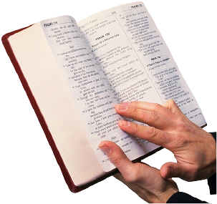
C.E.L.E.B.R.A.T.I.O.N.S.
B is for celebrating BELIEF
Petitional prayer
Ritual prayer
Meditative prayer
Colloquial prayer
Notes:
B is for celebrating Belief
In the past decade, more than one thousand research studies have been conducted by researchers from Harvard, Duke, and Yale universities on the effects of faith, prayer and meditation. Instead of documenting neurosis as a result of believing in God, five hundred of the studies demonstrated significant positive associations, such as better mental health, greater well-being; less anxiety, depression, and substance abuse; lower suicide rates; more purpose and meaning in life; and greater marital satisfaction and stability.
These studies show that believing in God is a very positive benefit and promotes health. There is nothing more reassuring than the peace and satisfaction experienced by those who place their lives in the hands of a loving God who cares for each of us.
An Ohio study regarding the effects of prayer on well-being interviewed 560 respondents, 95 percent of whom classified themselves as religious people. The researchers identified four types of prayer:
Petitional prayer: praying to God for material things one may need
Ritual prayer: praying to God by reading the book of prayers.
Meditative prayer: praying to God by “feeling” or being in His presence.
Colloquial prayer: praying to God as talking to a friend, asking Him for guidance.

Slide 17
C.E.L.E.B.R.A.T.I.O.N.S.
“Sickness of the mind prevails everywhere. Nine-tenths of the diseases from which man suffers have their foundation here.”
Testimonies to the Church, Vol. 5, p. 444
Notes:
Of all these types of prayer, the study revealed that colloquial prayer correlates best with happiness and religious satisfaction. Talking to God as to a friend, telling Him all our joys and sorrows, can bring happiness, healing, and religious satisfaction. God wants us to develop a close relationship with Him by using this two-way communication. He speaks to us through the Bible in our private devotion, and we speak to Him through our colloquial prayer. This close relationship with our heavenly Father gives us peace of mind and helps us to cope with the stresses of life.
That stress is a major contributor to ill-health is supported by an article in U.S. News & World Report which states that “Somewhere between 75 and 90% of all doctor visits stem from stress.” Should this surprise us? Ellen G. White wrote more than 150 years ago: “Sickness of the mind prevails everywhere. Nine-tenths of the diseases from which man suffers have their foundation here.” (Testimonies to the Church, Vol. 5, p. 444)

Slide 18
C.E.L.E.B.R.A.T.I.O.N.S.
R is for celebrating REST
“Early to bed, early to rise, makes a man healthy, wealthy, and wise.”
Notes:
R is for celebrating Rest
The saying “Early to bed, early to rise, makes a man healthy, wealthy, and wise,” is definitely true. Ever since the discovery of “circadian” rhythms or what is known as the natural daily clock, medical science has found that there are many hormones released during sleep, such as the Growth hormone, Cortisol hormone, Prolactin, FSH (Follicle Stimulating Hormone), Luteinizing hormone, and so forth. Let’s consider just the Growth hormone:
it is produced during pre-midnight sleep (latitude)
It is important for growth
it increases the amino acid transport to the brain (tryptophan to pineal gland to convert serotonin to melatonin)
it makes learning permanent and useful
its absence impairs immunity (production of cytotoxic T cells)

Slide 19
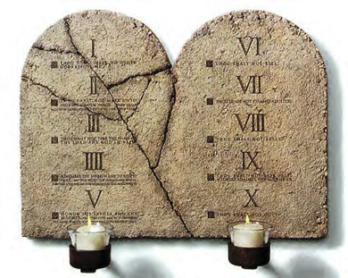
C.E.L.E.B.R.A.T.I.O.N.S.
“Remember the Sabbath day, to keep it holy. Six days you shall labor and do all your work, but the seventh day is the Sabbath of the Lord your God. In it you shall do no work.”
Exodus 20:8-10
Notes:
Going to bed early helps us mentally and physically. It is interesting that Mrs. White wrote about this matter 150 years ago, pointing out that “Sleep is worth far more before than after midnight; two hours good sleep before twelve o’clock is worth more than four hours after twelve o’clock.”
Rest is vital to optimal health and vitality, and it is important to remember that there are several types of rest. We need daily rest and also weekly rest. God invites us to enjoy a special day of rest each week. He says to us, “Remember the Sabbath day, to keep it holy. Six days you shall labor and do all your work, but the seventh day is the Sabbath of the Lord your God. In it you shall do no work.” Exodus 20:8-10.
As Rev. Ashey, a Virginia pastor, wrote in The Washington Times, “Sabbath is the antidote to burnout.” God who is our Creator knows that our body needs weekly rest in addition to daily rest. Guarding our health also includes taking time for our annual vacation .

Slide 20
C.E.L.E.B.R.A.T.I.O.N.S.
A is for celebrating AIR
When we exercise outdoors, we are enjoying three prescriptions all at one time—getting exercise, absorbing vitamin D from the sunshine, and benefitting from the oxygen provided by the green trees.
Notes:
A is for celebrating Air
A person carries approximately two quarts of oxygen in the blood, lungs and body tissues. That is enough to last for four minutes. For our health, it is important to breathe plenty of fresh air.
Ellen G. White understood the importance of fresh air: “The influence of pure, fresh air is to cause the blood to circulate healthfully through the system. It refreshes the body and tends to render it strong and healthy, while at the same time its influence is decidedly felt upon the mind, imparting a degree of composure and serenity. It excites the appetite, and renders the digestion of food more perfect, and induces sound and sweet sleep.”
Exercise in the outdoors can be especially invigorating if we are surrounded by green trees, which are God’s miraculous anti-pollution mechanism. The trees take in the carbon dioxide we exhale and give off the oxygen we need. When we exercise outdoors, we are enjoying three prescriptions all at one time—getting exercise, absorbing vitamin D from the sunshine, and benefitting from the oxygen provided by the green trees.

Slide 21
C.E.L.E.B.R.A.T.I.O.N.S.
T is for celebrating TEMPERANCE
“True temperance teaches us to dispense entirely with everything hurtful and to use judiciously that which is healthful.”
Ellen G. White, Patriarchs and Prophets, p. 562
Notes:
T is for celebrating Temperance
Ellen G. White gave us guidance many years ago: “True temperance teaches us to dispense entirely with everything hurtful and to use judiciously that which is healthful.” (Patriarchs and Prophets, p. 562)As we see from her words, true temperance consists of not one but two parts: Abstinence from things that are bad for us, such as alcohol, tobacco and the other illegal drugs; and moderation in even the good things.
Even healthful things in excess may impact our bodies negatively. For instance, drinking water is good, but too much water can lead to water intoxication. Therefore even in good things one must practice moderation in order to have optimal health. We must learn to live balanced lives!

Slide 22
C.E.L.E.B.R.A.T.I.O.N.S.
I is for celebrating INTEGRITY
“It is not safe to permit the least departure from the strictest integrity.”
Ellen G. White,
Testimonies to the Church, Vol. 2, p. 306
Notes:
I is for celebrating Integrity
Ellen G. White wrote, “It is not safe to permit the least departure from the strictest integrity.” (Testimonies to the Church, Vol. 2., p. 306)
When there is a difference between what we say and what we do, we demonstrate a lack of integrity. We need to ask ourselves “Am I always honest” “Can I be trusted?” “Can my spouse trust me implicitly?” “Do I trust myself?” Lack of integrity causes remorse, grief and broken relationships. Remember, character is what we are when no one sees. Do we have the peace that comes from knowing we are honest in all things? Are we comfortable knowing that God sees all?

Slide 23
C.E.L.E.B.R.A.T.I.O.N.S.
O is for celebrating OPTIMISM
“And we know that all things work together for the good of them that love God.”
Romans 8:28
Notes:
O is for celebrating Optimism
Optimism is based on faith in God. There is no reason to be angry or depressed or sad, knowing that whatever happens in our lives is allowed by God for a reason and it is always for our best.
Romans 8:28 assures us, “And we know that all things work together for good to them that love God.”
Research done at the Institute of Mental Health in the Netherlands studied 545 men between the ages of 64 to 84 who were free from preexisting cardiovascular disease and cancer. The men were given a four-item questionnaire every five years from 1985 to 2000 to assess their level of optimism. Then these men were divided into three groups based on the optimism scores, and the number of cardiovascular deaths were compared. Highest optimism scores had an approximately 50 % lower risk of cardiovascular death! For our health, let’s celebrate life and approach each day with faith and optimism.

Slide 24
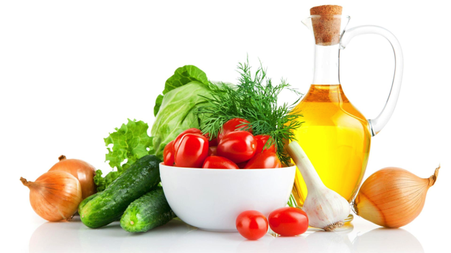
C.E.L.E.B.R.A.T.I.O.N.S.
N is for celebrating NUTRITION
We can celebrate at each meal, choosing a rainbow of colorful fruits and vegetables and reducing our use of processed foods, salt and sugar.
Notes:
N is for celebrating Nutrition
God loves us. When He created Adam and Eve, He showed them what to eat to be healthy. We can celebrate at each meal, choosing a rainbow of colorful fruits and vegetables and reducing our use of processed foods, salt and sugar.
Hubert Warner, PhD, at the National Institute of Aging, says, “What we know is that diets rich in fruits and vegetables appear to be much healthier, leading to less chronic disease and lower healthcare costs, but it’s less clear how any specific dietary items affect longevity.” This advice is echoed by experts in an April 29, 2003 WebMD Feature, which states, “If you want to eat foods for living longer, consider a plant-based diet!”

Slide 25
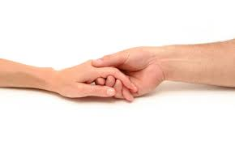
C.E.L.E.B.R.A.T.I.O.N.S.
S is for celebrating SOCIAL SUPPORT
Ellen G. White wrote, “Doing good is a work that benefits both giver and receiver.”
Notes:
S is for celebrating Social Support
Ellen G. White wrote, “Doing good is a work that benefits both giver and receiver.” A study done at the University of California Los Angeles (UCLA) involved 129 ethnically diverse, economically disadvantaged pregnant women to see if social support would improve physical and mental outcomes in pregnancy. They found that women who received more prenatal social support and those who were more satisfied with that support, experienced fewer labor difficulties, delivered healthier babies, and had higher birth weight babies. They also reported less depression.
A review of 144 studies on pregnant women concluded that intimate, loving support improves fetal growth, and women who feel loved and supported have less risk of premature births.
What are the benefits of supporting others to the giver? A study in the 1997 Journal of the American Medical Association looked at “Social ties and susceptibility to the common cold.” The subjects, 276 healthy volunteers, ranging in age from 18 to 55, were given nasal drops containing rhinovirus, the virus that causes the common cold. Their participation in 12 types of social relationships was assessed: relationships with spouse, parents, parents-in-law, children, close family members, close neighbors, friends, fellow workers, schoolmates, fellow volunteers in charity or community work, members of groups without religious affiliations (social, recreational or professional), as well as members of religious groups.
The research revealed that those who reported only one to three types of relationships had more than four times the risk of developing a cold than those reporting six or more types of relationships. These differences were not fully explained by antibody titers (levels), smoking, exercise, amount of sleep, alcohol, vitamin C, or other factors. In addition, the researchers discovered that the diversity of relationships was more important than the total number. In short, those involved in mutually supportive relationship with a diversity of people, regardless of their background, increased their resistance to infection with the rhinovirus.

Slide 26
God encourages us to support one another. Not only is it good for those receiving the support but also for the one giving support.
Notes:
God encourages us to support one another. Not only is it good for those receiving the support but also for the one giving support.

Slide 27
Love one another (John 13:35)
Forgive one another (Colossians 3:13)
Accept/receive one another (Romans 15:7)
Pray for one another (James 5:16)
Comfort one another (1Thessalonians 4:18)
Notes:
There are many verses in the Bible giving specific instruction on how to provide support and service to one another as one big family. For example,
Love one another (John 13:35)
Forgive one another (Colossians 3:13)
Accept/receive one another (Romans 15:7)
Pray for one another (James 5:16)
Comfort one another (1Thessalonians 4:18)

Slide 28
Fellowship with one another (1 John 1:7)
Be kind to one another (Ephesians 4:32)
Show compassion to one another (1 Peter 3:8)
Be hospitable to one another (1 Peter 4:9)
Notes:
Fellowship with one another (1 John 1:7)
Be kind to one another (Ephesians 4:32)
Show compassion to one another (1 Peter 3:8)
Be hospitable to one another (1 Peter 4:9)

Slide 29
“I can do all things
through Christ who strengthens me.”
Philippians 4:13
Notes:
As we maintain a strong vertical relationship with the Lord, we will reach out horizontally to support to others, treating each person as a child of God. The foot of the cross is level ground. There is no distinction of caste, race, income, education, or position, for each one of us has the same price—the blood of Jesus Christ. As we understand the value of every person, we can genuinely support one another from our hearts.
God cares about His children and gave us a wonderful prescription for abundant living. He has promised success to those who maintain a relationship with Him. Philippians 4:13 says, “I can do all things through Christ who strengthens me.” Let us respond to God’s loving prescription, the health principles He has given us that we may “have life and have it more abundantly.”

Slide 30
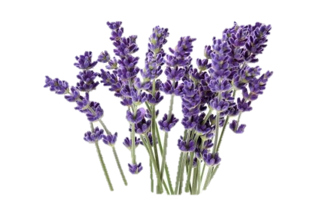
Prayer
“I am come that they might have life, and that they might have it more abundantly.”
John 10:10
Notes:
Prayer
“I am come that they might have life, and that they might have it more abundantly.” John 10:10

